Slide 1
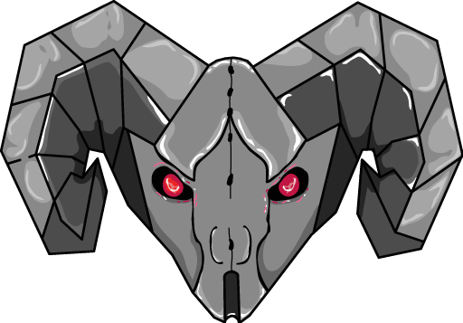
Team 999
MechaRAMS
Vision for the Drive Team
New robot behaviors, test-driving duties, and what to watch for
Follow-up to “Robot Localization & Precision Driving” — short and practical
For students and mentors · Summer 2026

Slide 2
Why the drive team is part of the test plan
Team 999
MechaRAMS
The on-carpet test steps are DRIVEN tests — your hands, your placement discipline, your observations.
The decision rule is best WORST-CASE over 5 runs: one sloppy run doesn't average away, it decides. Consistency is the whole job.
Your eyes are a sensor: everything is logged, but logs are found by time — “aim felt off around 0:40 in run 3” is how a 2 GB log becomes a 10-second lookup.
THE 2026 LESSON
Last season the robot missed and nobody could say why. This season every miss is explainable — but only if runs are disciplined and observations get reported.
2

Slide 3
New behaviors — don't fight the robot
Team 999
MechaRAMS
What you'll see | What it is | What to do
Auto path “ends” but robot keeps creeping to a spot | the handoff — precision controller finishing on POSITION, not time | let it finish; do not touch the sticks
Robot sits still ~¼ second before acting “done” | the settle gate — must HOLD tolerance, not just touch it | normal; count it in your cycle rhythm
Robot gives up an approach after ~4 s | safety timeout — bad target or blocked path | report it with the run time; it's logged as a timeout
Brief pause in vision corrections after a pose reset | 0.35 s quarantine discarding stale camera frames | expected; drive normally
3

Slide 4
Test-robot controls (one Xbox controller)
Team 999
MechaRAMS
Control | Action
Left stick / Right stick X | field-relative drive / rotate
Right bumper (hold) | slow mode — 35% speed, for precise manual lineups
A (press) | reset pose to test start (1.5, 2.0, 0°) — STATIONARY ONLY; ignored during enabled auto
X (press) | precision drive to the tag-board test pose (4.25, 2.0, 0°)
Right trigger (hold) | drive while auto-aiming at the virtual goal (shoot-on-move lead)
Right stick press | stationary square-up to the goal until settled
Y (hold) | stop drivetrain
D-pad + bumper/trigger combos are SysId characterization — only on request, only with the robot prepared for it.
4

Slide 5
The auto chooser — run exactly what the checklist says
Team 999
MechaRAMS
The chooser has baseline autos AND “AB:” experiment autos (TrigSolve / AnisoCov combinations, straight and curved).
The checklist names the exact option per run. The selected name is logged automatically — but the fastest way to ruin a test day is running the wrong config on the right path.
Read the name out loud before enabling. Seriously.
Between runs: A-press reset ONLY when the robot is stationary at the start marks; never mid-auto (the button is ignored there, by design).
Chooser options (sample)
VisionTest (baseline)
VisionTest (spatial handoff)
VisionTestCurved (spatial handoff)
Precision To Tag Board
AB: ... (TrigSolve)
AB: ... (AnisoCov)
AB: ... (TrigSolve+AnisoCov)
red = experiment configs — tests only, never matches
5

Slide 6
Test-day driving discipline
Team 999
MechaRAMS
Same start, every run
5 runs, no heroes
Between runs
Robot placed on the taped start marks the same way each time (a placement jig helps). The runs are compared 1:1 — a 3 cm placement slop looks identical to a 3 cm algorithm error.
Each configuration gets 5 identical runs; worst one counts. Don't “save” a bad run with a stick correction — a corrupted run is worse than a bad one. Call it, log the time, redo.
Reset only when stationary on the marks. Confirm the chooser. Give the battery a glance — sagging voltage changes drivetrain behavior and contaminates comparisons.
6

Slide 7
What to watch for and report (with run + time!)
Team 999
MechaRAMS
1
Aim feels off / shot line looks wrong — the 2026 symptom — now findable in logs if you timestamp it
2
Pose jump — robot “teleports” on the dashboard field view — possible bad frame or reset issue
3
Robot “breathes” toward/away from the board while parked — the covariance drift the oval model should fix — key observation
4
Oscillation or shimmy at the end of a precision approach — gains or settle tuning
5
Any timeout (approach gives up at ~4 s) — target/obstacle problem; logged, but say it anyway
6
Anything that felt different from the last identical run — difference between identical configs is exactly what we hunt
7

Slide 8
What changes for competition
Team 999
MechaRAMS
After the evaluation (step R5), the robot runs ONE fixed configuration — the winner. No vision mode switches on the driver station, ever. A mode you haven't practiced is a liability, not a feature.
You'll practice with exactly the competition config; the AB: options remain for regression tests, not for matches.
The per-frame smartness stays automatic: 2 tags → multi-tag, 1 tag → winner, bad frame → rejected. The robot handles it 50× a second; you drive.
Expect the handoff rhythm in autos: fast transit → cross the line → precise finish → settle. Plan your cycle timing around the settle beat.
YOUR ROLE IN THE DECISION
The configuration that wins is the one with the best worst-case — which your disciplined test driving determines. You are choosing your own competition robot.
8

Slide 9
Drive team takeaways
1. Let it finish. Handoff creep and the settle pause are the precision working — hands off until it's done.
2. Consistency beats heroics. Same placement, right chooser option, 5 clean runs. The worst run decides, and corrections corrupt data.
3. Say what you saw, with the time. Your observation is the index into the logs — it turns feelings into findings.
Questions?

